Slide 1



TOP25 RESTAURANTS & TOP25 HOTELS KENYA
Your Gateway to Premium Recognition, Bookings & ROI
Be Seen. Be Trusted. Be TOP25

Slide 2
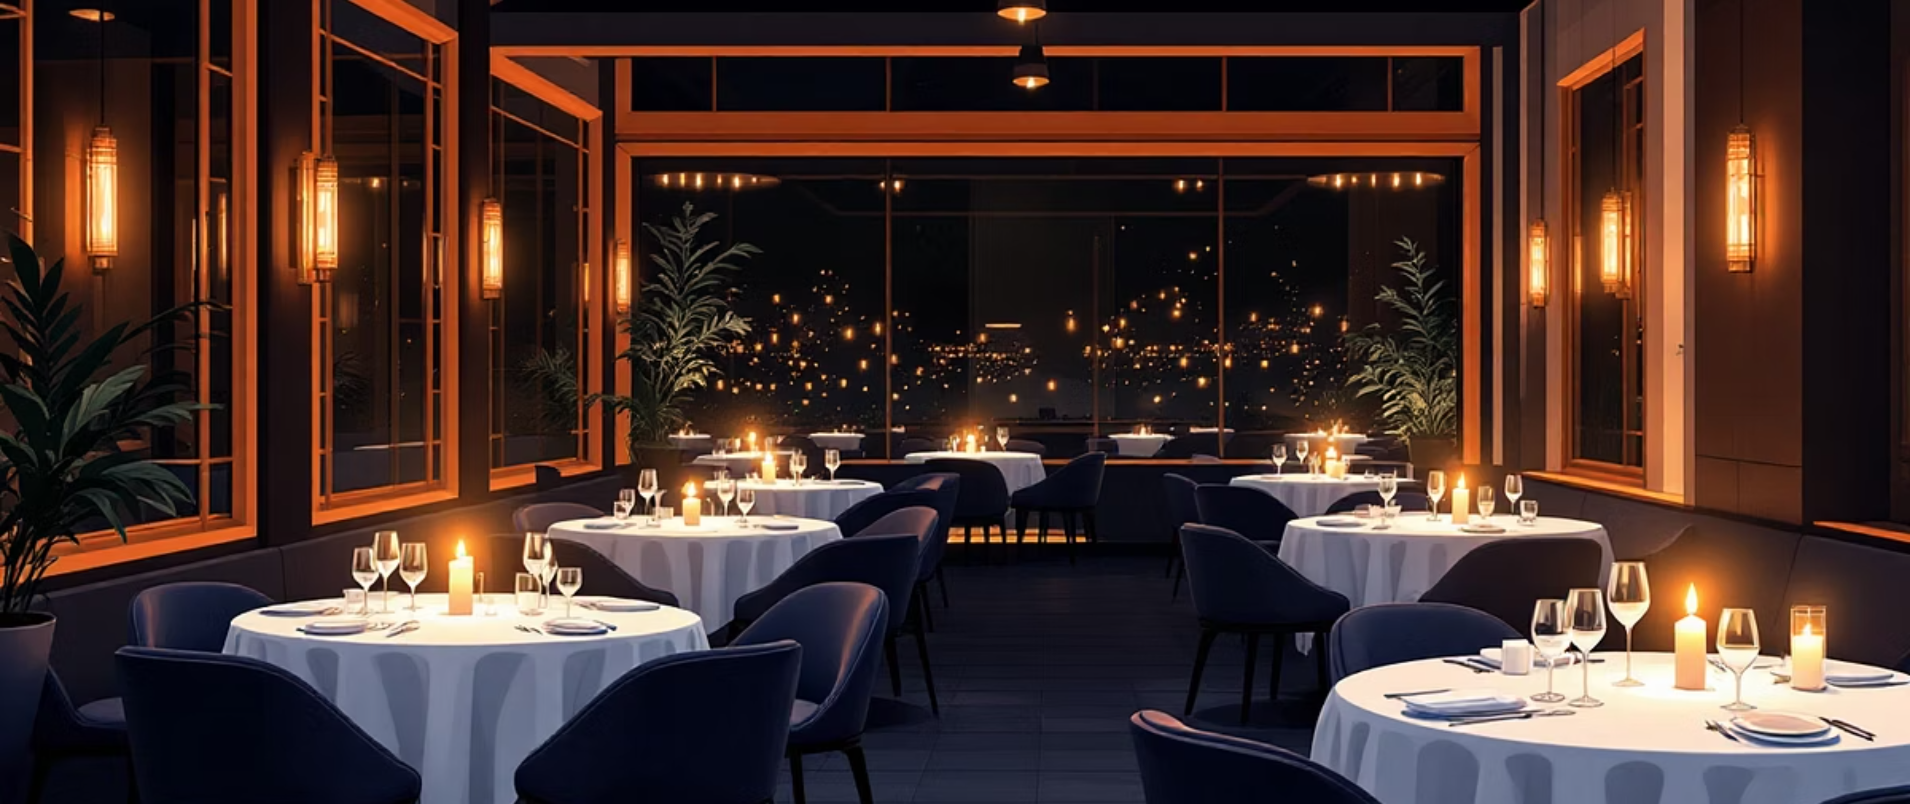

Recognition Now Directly Impacts Revenue
Fast Evolution
Kenya's hospitality scene is evolving rapidly, with digital recognition now directly driving revenue growth.
More Than Prestige
Being featured means more than prestige—it's proof of trust and quality that converts browsers into bookers and diners into loyal guests.

Slide 3

Where Recognition Meets Measurable Results
01
Award System
Premium recognition program that positions your property among Kenya's elite hospitality brands.
02
Digital Promotion
Multi-channel digital exposure across curated platforms where travelers actively search for premium experiences.
03
Curated Storytelling
Professional brand narratives that showcase your unique value proposition to the right audience.
04
Lasting Visibility
Continuous presence among travelers, media, and industry partners throughout the year.
Join Kenya's most trusted hospitality ranking network, where recognition meets measurable results.

Slide 4
WHY PARTNER WITH TOP25?
1
Boost Conversions
Increase direct bookings and in-property guest spending through trusted recognition.
2
Elevate Positioning
Strengthen brand prestige and market trust among high-value travelers.
3
Reduce Costs
Cut PR and agency costs with built-in media value and professional storytelling.
4
Exclusive Access
Access exclusive collaborations and seasonal campaigns that drive revenue.
Be Seen. Be Trusted. Be TOP25

Slide 5

PACKAGE OPTIONS
TOP25 HOTELS KENYA
Premium Recognition with Proven ROI
Comprehensive visibility across TOP25Hotels.com and curated digital channels. Position your property among Kenya's elite accommodations and drive measurable booking growth.
TOP25 COMBI PACKAGE
Hotel + Restaurant
Complete digital marketing advantage that captures the full guest journey from booking to dining. Premium positioning for hospitality leaders.

Slide 6

TOP25 HOTELS KENYA
Premium Recognition with Proven ROI
Commercial Value
Increase direct booking conversion through trusted recognition that travelers actively seek.
Close More Deals
Win more corporate, group, and travel trade bookings with proven credibility.
Premium Positioning
Support premium positioning and reduce reliance on discounts to maintain brand equity.

Slide 7
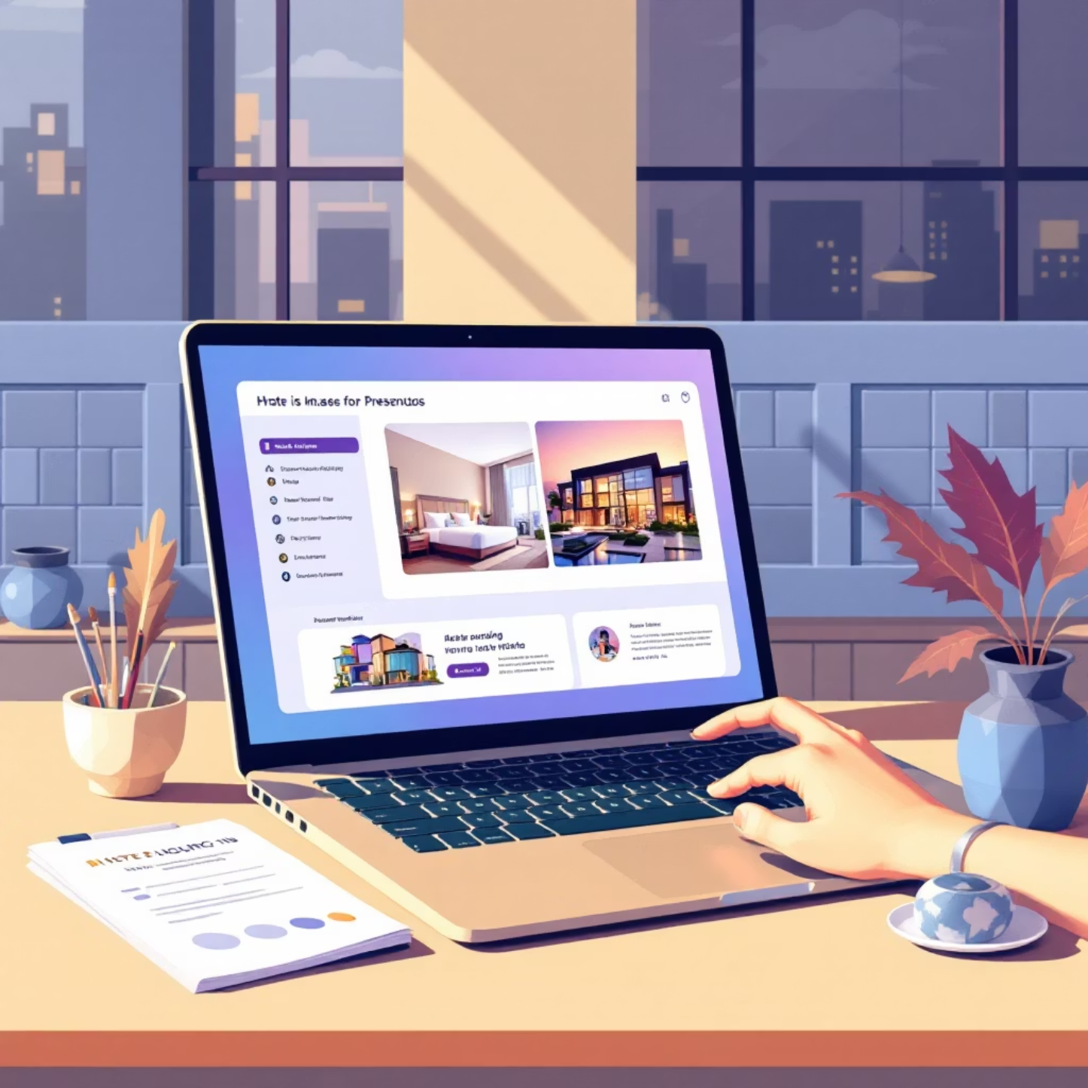
Marketing Value & Cost Savings
Marketing & Visibility
Professionally written hotel story featured on TOP25Hotels.com
Continuous curated visibility via TOP25 content, partners, and press
Reduces dependency on external PR and agency support
Sales Enablement
Guest Quality & Retention
Leverage TOP25 status in decks, proposals, and presentations
Strengthen credibility for international and first-time guests
Clear category positioning (Luxury, Resort, Beach, Safari, Camp)
Attract the right guests, boost satisfaction, encourage repeat visits

Slide 8

Priority Access
Early Campaign Access
First inclusion in TOP25 campaigns and collaborations before general release.
Experiential Opportunities
Priority access to experiential and seasonal revenue opportunities throughout the year.
Measurable Growth
Recognition that drives measurable business growth through strategic positioning.

Slide 9




TOP25 COMBI PACKAGE
Hotel + Restaurant
Complete Experience
Guests want a complete experience, not just a great stay. Combines TOP25 Hotels + TOP25 Restaurants to position your property as a true destination.
Full Guest Journey
Captures the full guest journey from booking to dining, increasing spend, loyalty, and satisfaction.
Unified Marketing
Reduces marketing costs through shared storytelling and unified digital exposure across both platforms.
The Complete Digital Marketing Advantage
Premium | Limited | Exclusive

Slide 10

Revenue Impact & Why TOP25 Works
Instant Revenue Impact
Increase guest spend per stay through guided dining experiences
Capture more in-house dining revenue and retain guest spend
Stronger F&B Performance
Drives reservations and average spend
Encourages higher occupancy during weekends and special occasions
Longer Stays & Repeat Visits
"Stay + Dine" positioning creates a full-experience journey
Guests stay longer and return for culinary experiences
Why TOP25 Works
Measured ROI
Trackable impact on bookings, guest spend, and brand equity throughout the year.
Sustained Prestige
Recognition that lasts all year, not just a single event or campaign.
Smart Scalability
Grow reach without losing exclusivity or diluting brand positioning.
Become one of Kenya's TOP25 recognized hotels or restaurants
Contact: caroline.mwangi@TOP25restaurants.com
Websites: TOP25Hotels.com | TOP25Restaurants.com
Be Seen. Be Trusted. Be TOP25

